Slide 1

Web Development
ALL YOU NEED TO KNOW ABOUT WEB DEVELOPMENT
By: Asianzu Henry .D

Slide 2

WHAT IS WEB DEVELOPMENT
Web development, also known as website development, refers to the tasks associated with creating, building, and maintaining websites and web applications that run online on a browser. It may, however, also include web design, web programming, and database management.
Web developers create functional, user-friendly websites and web applications.

Slide 3

TYPES OF WEB DEVELOPMENT
FRONTEND DEVELOPMENT
BACKEND DEVELOPMENT
The Frontend refers to all the visual things you see on a web page.
The Backend is what saves and manages you data.
That is to say; the text, images fonts colors, videos, animation, buttons, etc…
For example your order on Jumia or Amazone, or your WhatsApp messages.

Slide 4
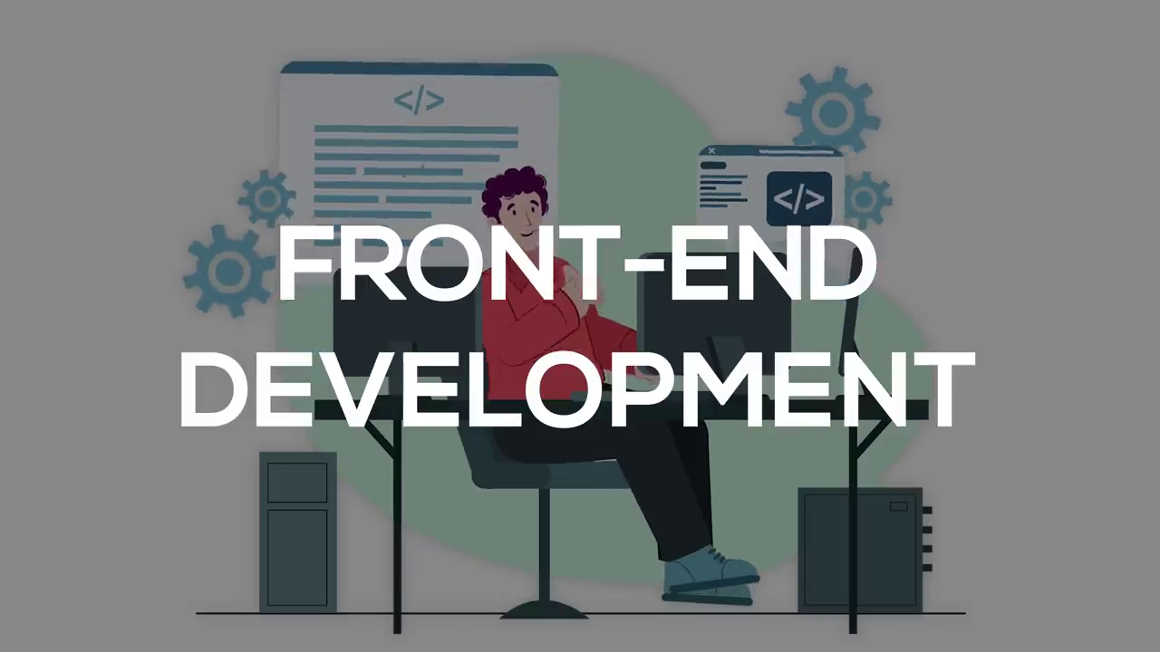
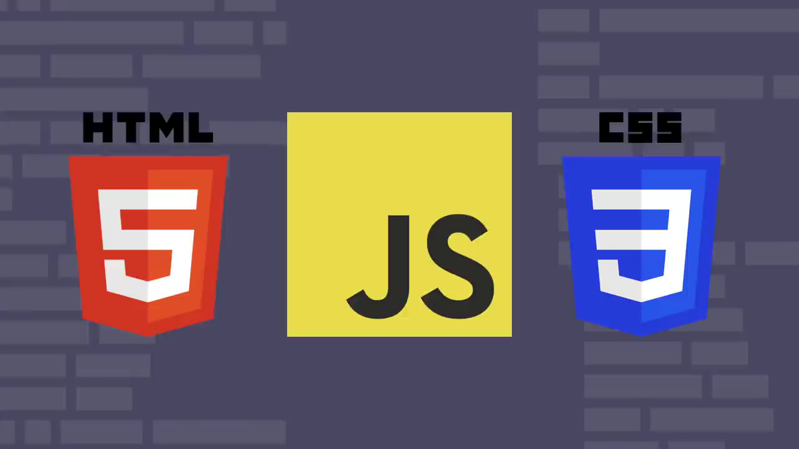
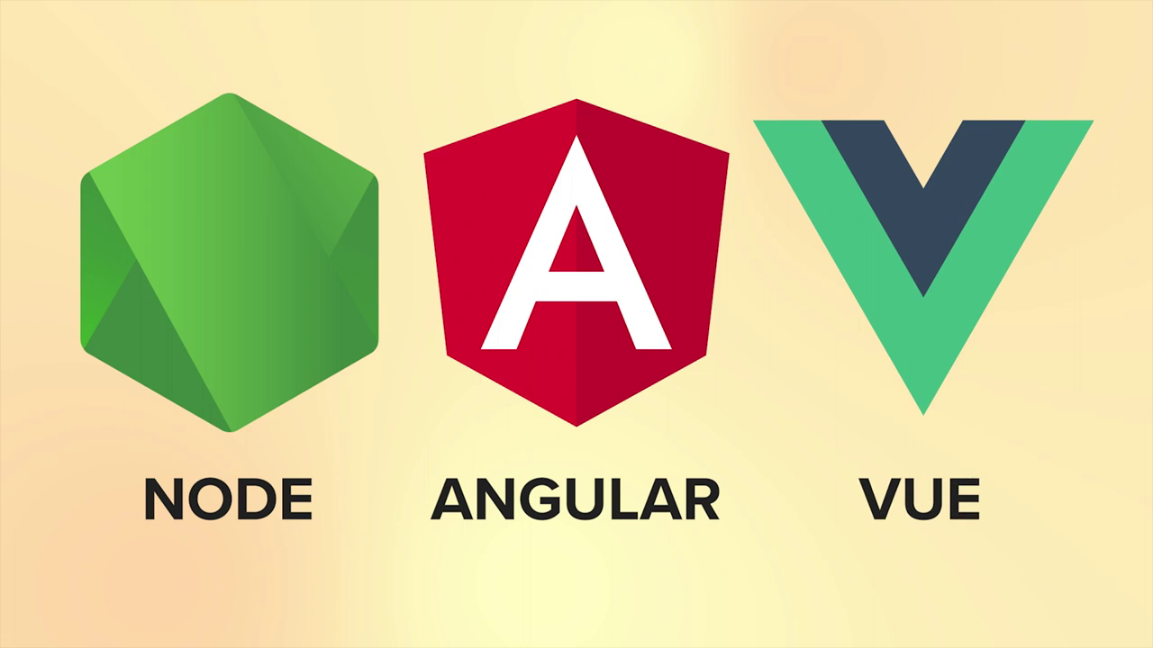
FRONTEND Web DEVELOPMENT
This is developing of the visual content on a website.
Frontend Developers are mainly responsible for designing of the overall look of a website.
The main programming languages for Frontend Development include; HTML(Hyper Text Markup Language), CSS(Cascading Style Sheets), and JS(JavaScript).
HTML is used to display content on a web page.
CSS adds styling to the content.
JS makes the web page responsive.

Slide 5
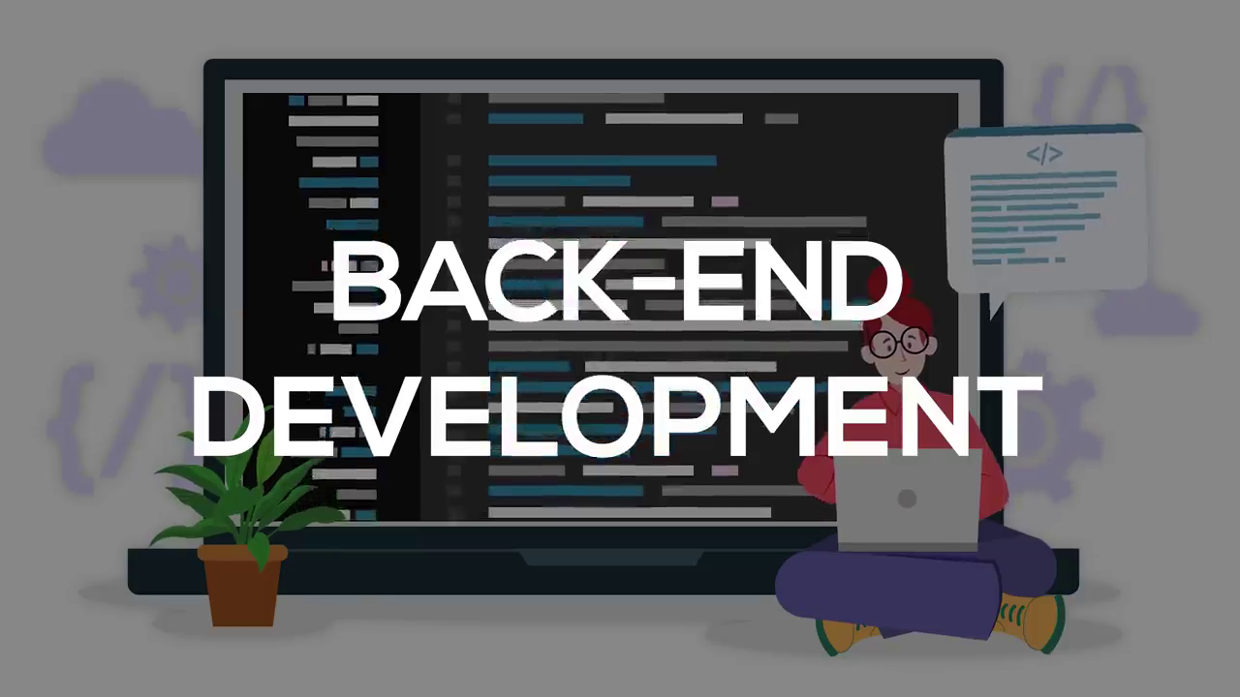
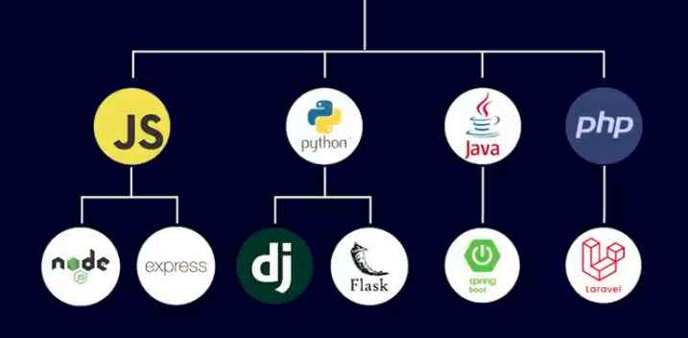
BACKEND DEVELOPMENT
This refers to the use of different technologies in order to information to the end users.
Backend Developers are mainly responsible for the following
Getting information to the end users.
Securing user credentials such as passwords, emails, payment records, etc.
Storing user data in databases.
The backend can be written in different languages. Some of these languages include; JavaScript, Python, Java, php, Rust, Go, Ruby, etc.

Slide 6
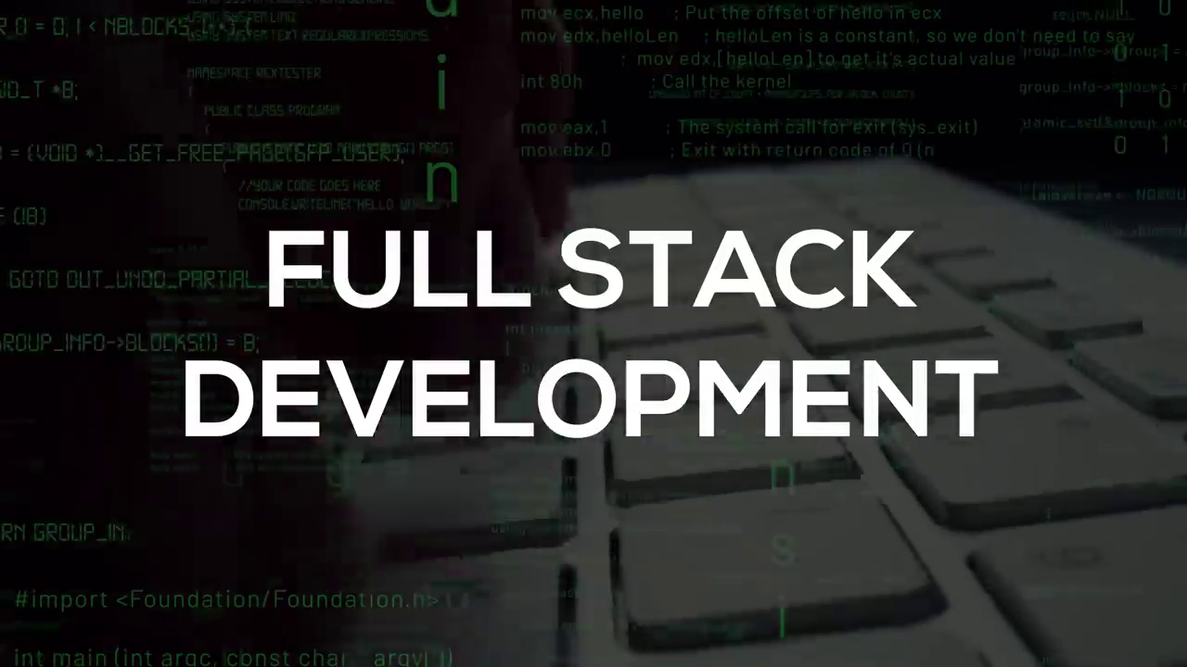
FULLSTACK DEVELOPMENT
Full stack development is the process of developing both the frontend and backend of applications. Any application has a frontend (user-facing) component and a backend (database and logic) component. The frontend contains the user interface and code related to user interactions with the application.

Slide 7
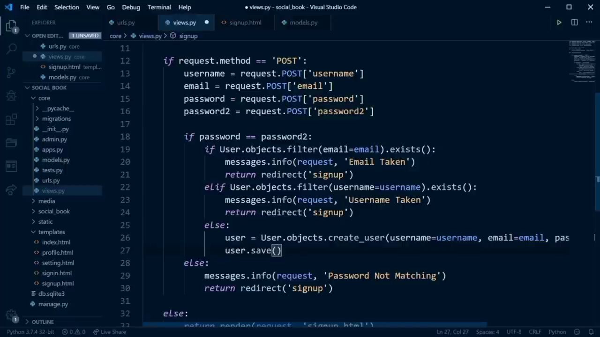
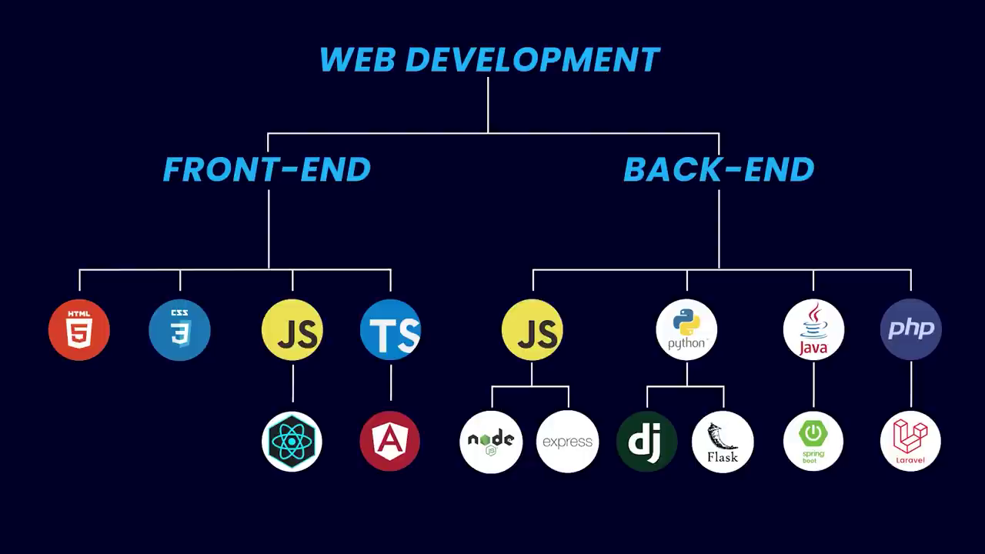
WED TECHNOLOGIES

Slide 8
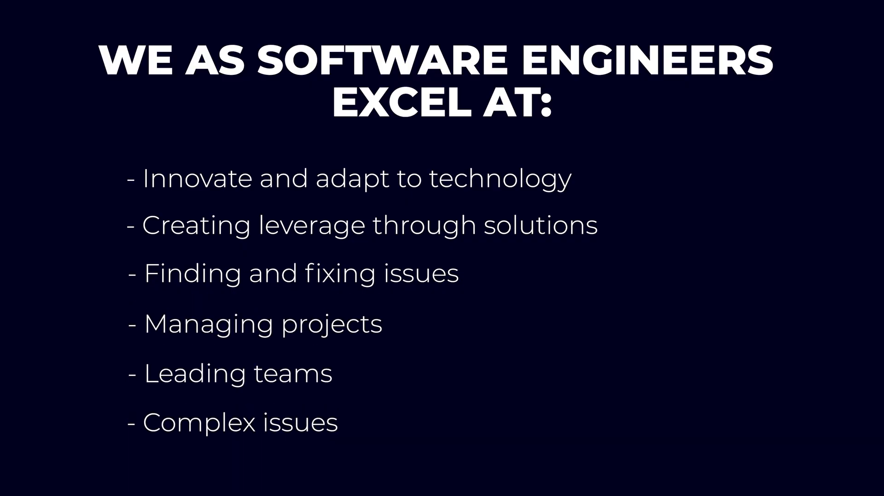

Slide 9






SOME OF THE TOP DEVELOPERS YOU SHOULD KNOW ABOUT
Tech With Tim
Hakirat Sing
Internat Made Coder
Andy Sterkowitz
Asianzu Henry

Slide 10
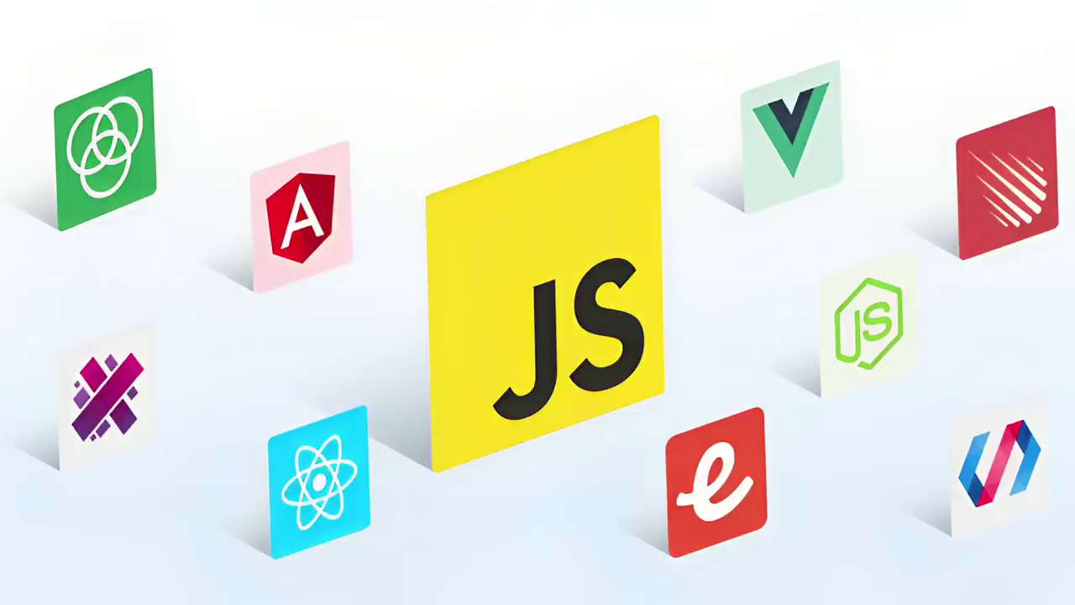
Conclusion
In this session, you have learnt that web development refers to the tasks associated with creating, building, and maintaining websites and web applications that run online on a browser.
Web developers create functional, user-friendly websites and web applications.
There are three types of web developers. These are Frontend developers, Backend developers, and Full stack developers.
GOD LOVES YOU

